Slide 1
World Happiness
Team-
Archana Karri
Rasika Senadheera
Myrna Deseo
Neha Sharma

Slide 2

Introduction -
World happiness report, factors affecting the rankings, life ladder and happiness post pandemic.
Data source -
https://view.officeapps.live.com/op/view.aspx?src=https%3A%2F%2Fhappiness-report.s3.amazonaws.com%2F2022%2FDataForTable2.1.xls&wdOrigin=BROWSELINK
Happiness report –
Life ladder –
Analysis focus –
Factors impacting on the life ladder, trends in the life ladder, Performance of Australia and post pandemic changes.

Slide 3
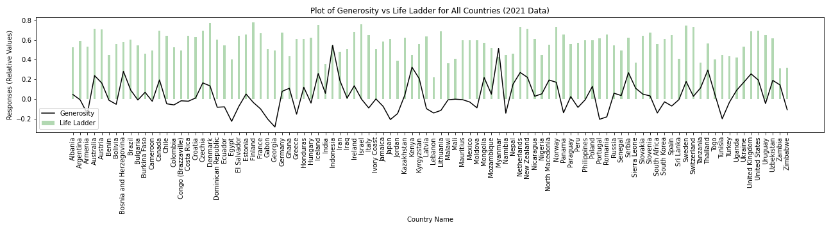
Effect of Generosity on Life Ladder
There seem to be no direct relation between Generosity and Life Ladder
However, it can be seen that for some countries Life Ladder almost follows Generosity.

Slide 4
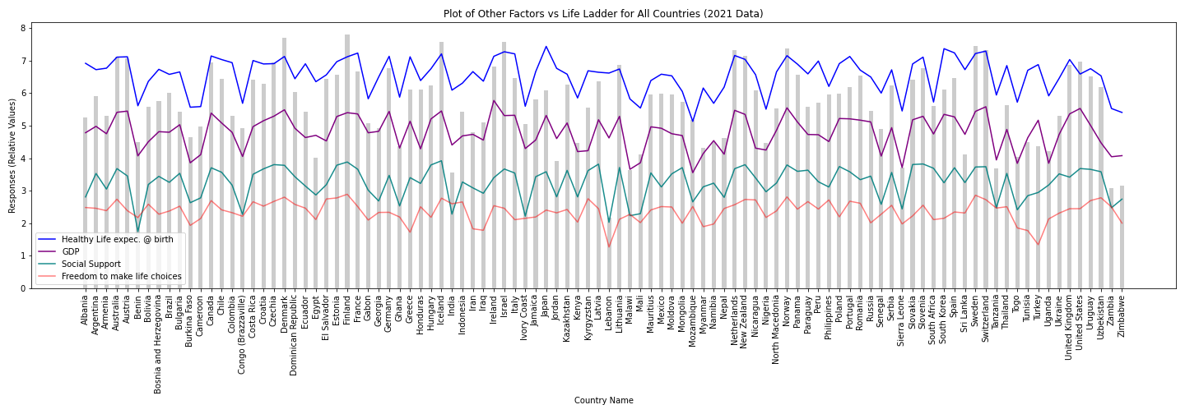
Effect of other samples on Life Ladder
Life Ladder seems to be resonating with Social Support
However, there also seems be a relation between GDP and Life Ladder
‘Freedom to make life choices’ is least related of all

Slide 5
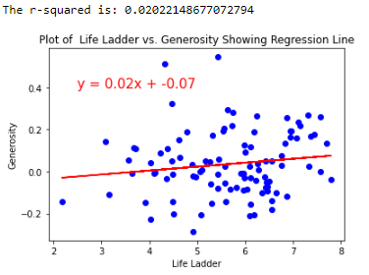
Effect of Generosity on Life Ladder

Slide 6
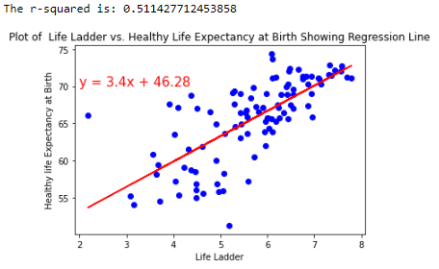
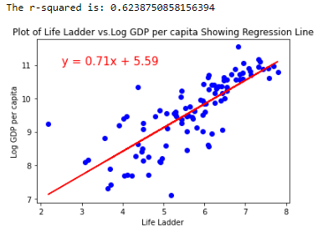
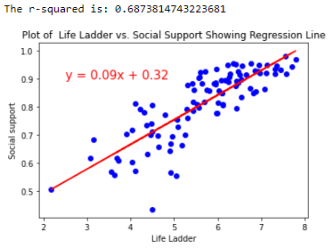
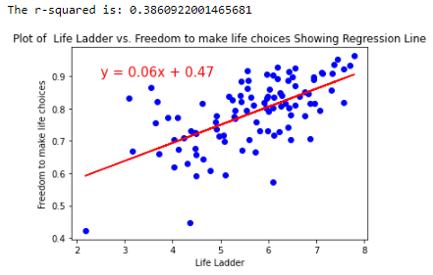
Life Ladder vs Other Factors

Slide 7
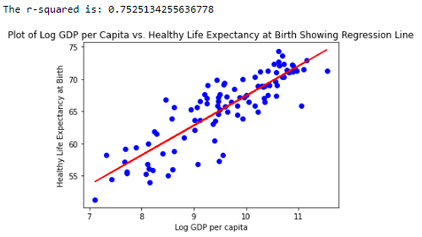
Log GDP per Capita vs Healthy Life Expectancy

Slide 8
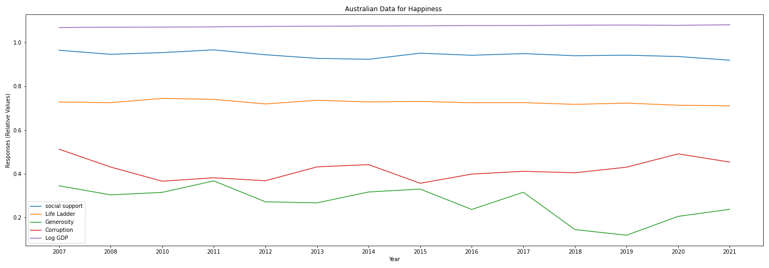
Australian Data for Happiness
Add text, images, art, and videos.
Life Ladder seems to be resonating with Social Support, which is same for other countries as we saw earlier

Slide 9
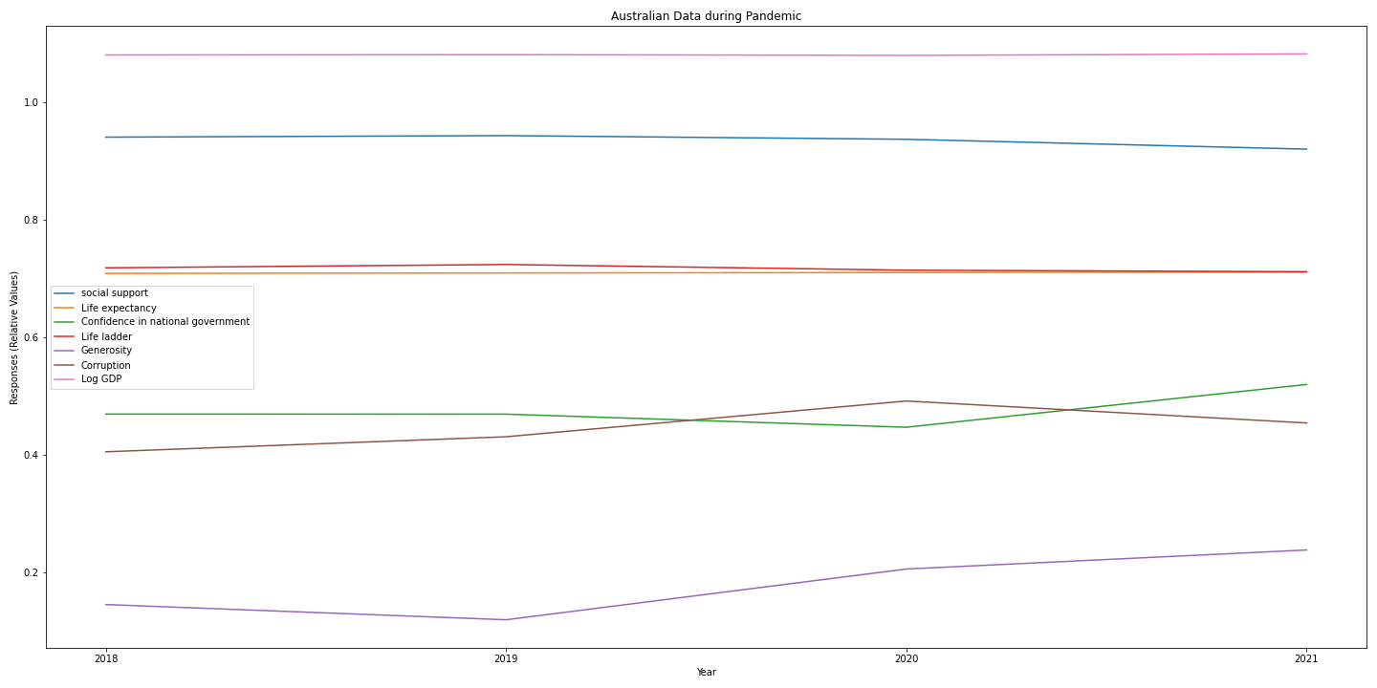
Australian Data during Pandemic
Only noticeable factor are Confidence in national government and Generosity
While Confidence in national government dipped slightly during 2020 it was higher than before by 2021
Generosity seems to have increased after 2019 and continues to grow steadily.

Slide 10




Thank you
Team-
Archana Karri
Rasika Senadheera
Myrna Deseo
Neha Sharma

